Slide 2
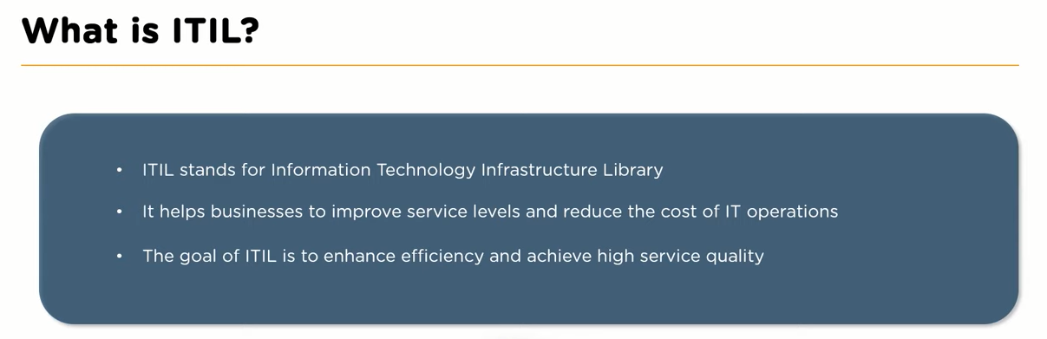

Slide 3
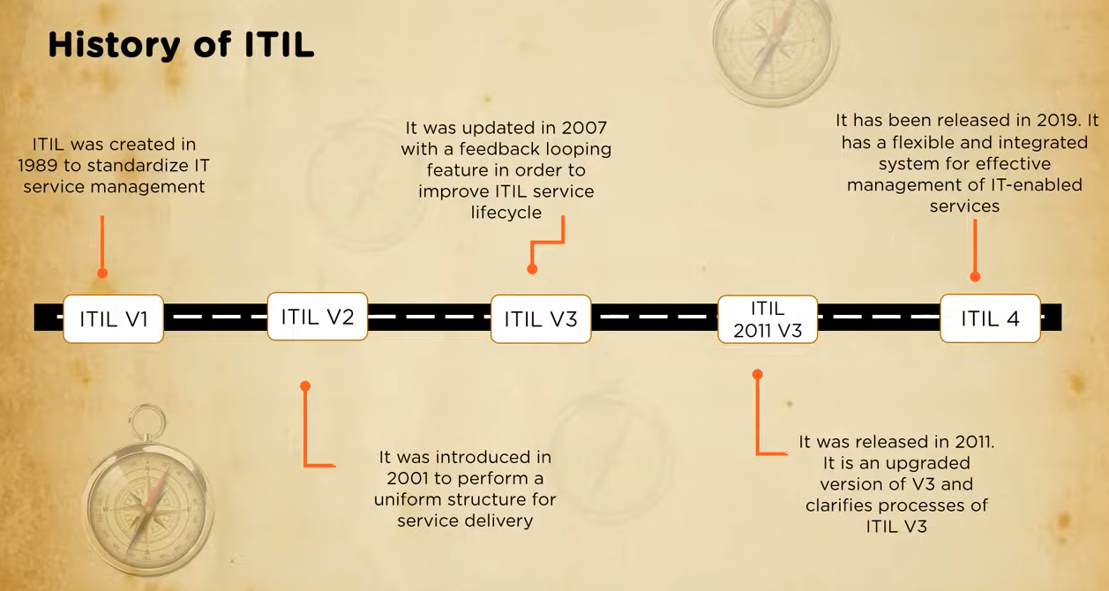

Slide 4
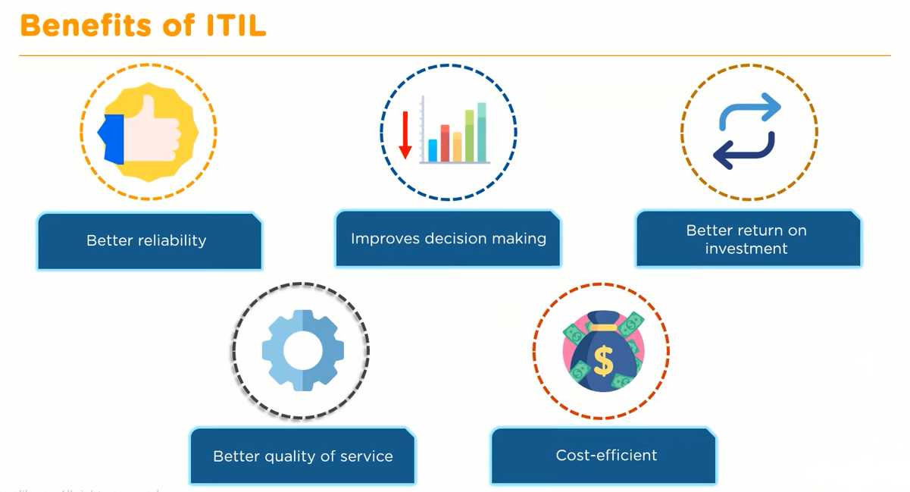

Slide 5
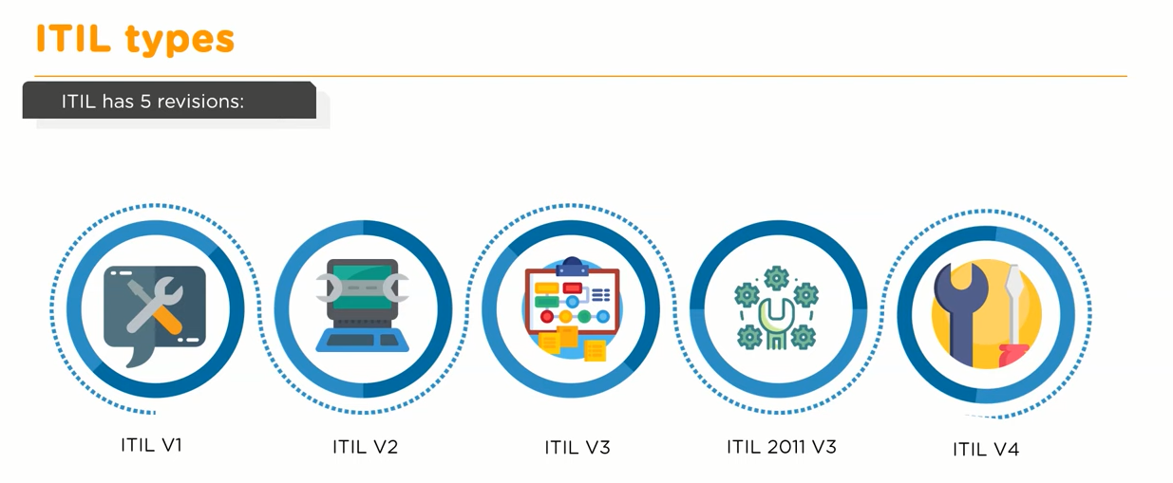

Slide 6
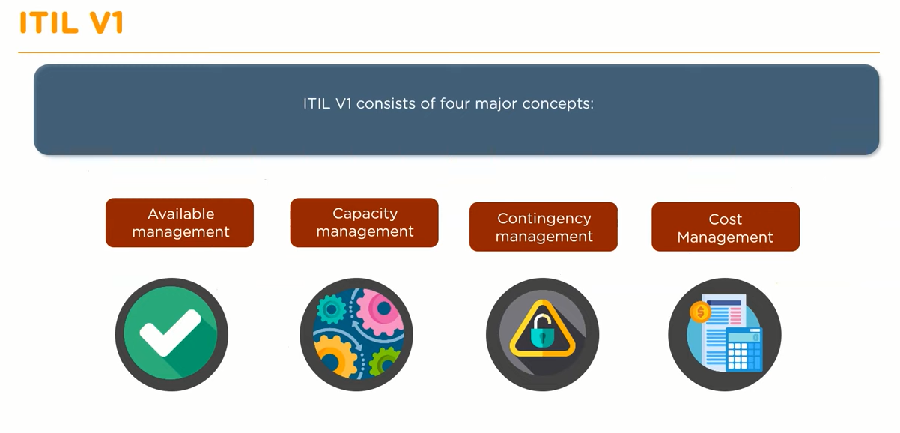

Slide 7
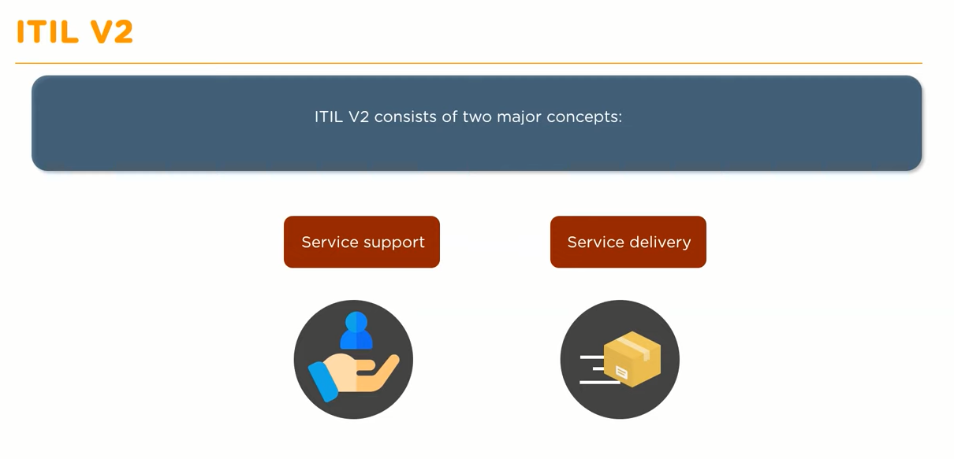

Slide 8
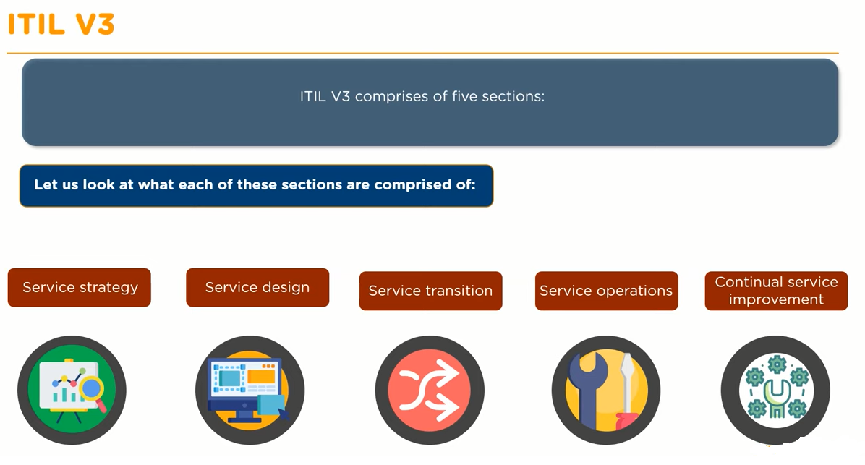

Slide 9
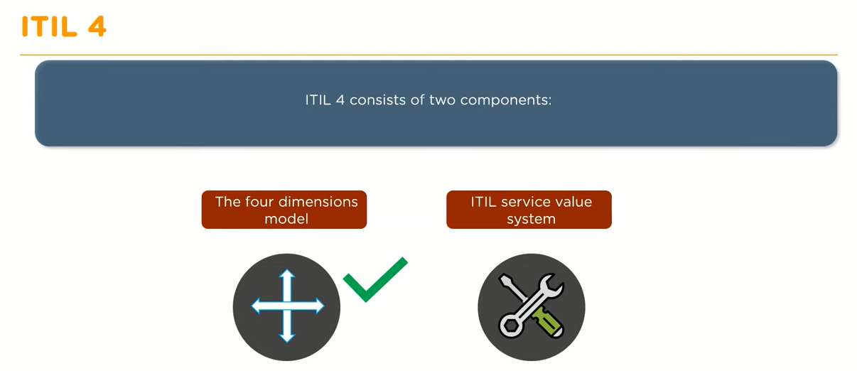

Slide 10
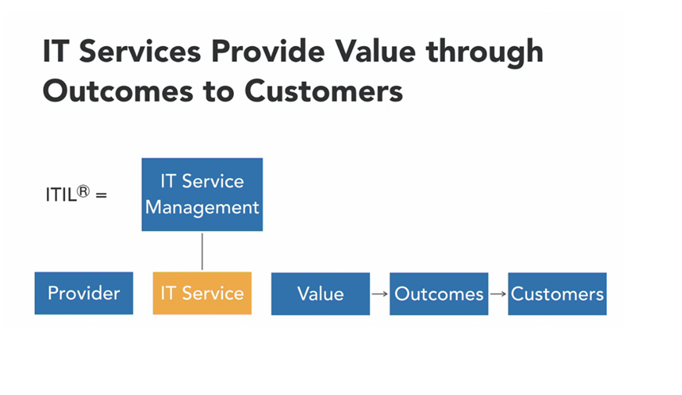

Slide 11
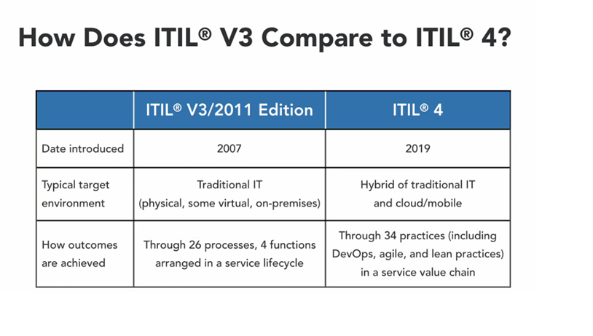

Slide 14
Service Level Management
This process belongs to Service Design phase
Service Level Management is responsible for negotiating Service Level Agreements, gathering service requirements and monitoring and reporting of agreed service levels

Slide 15
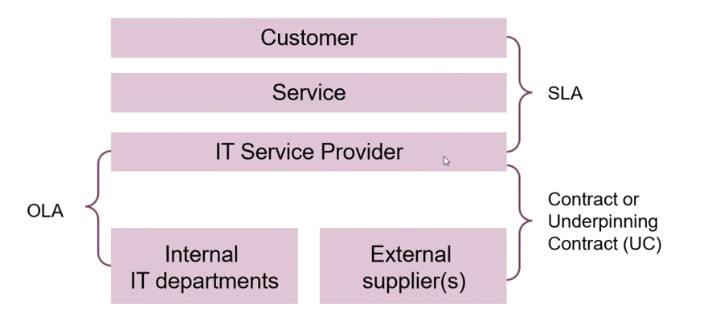
SLR -- Service Level Requirement
SLA – Service Level Agreement
OLA – Operational Level Agreement
UC – Underpinning Contract

Slide 16
Change Control
change control practice is to maximize the number of successful service and product changes by ensuring that risks have been properly assessed, authorizing changes to proceed, and managing the change schedule
Change is the addition, modification, or removal of anything that could have a direct or indirect effect on services.

Slide 17
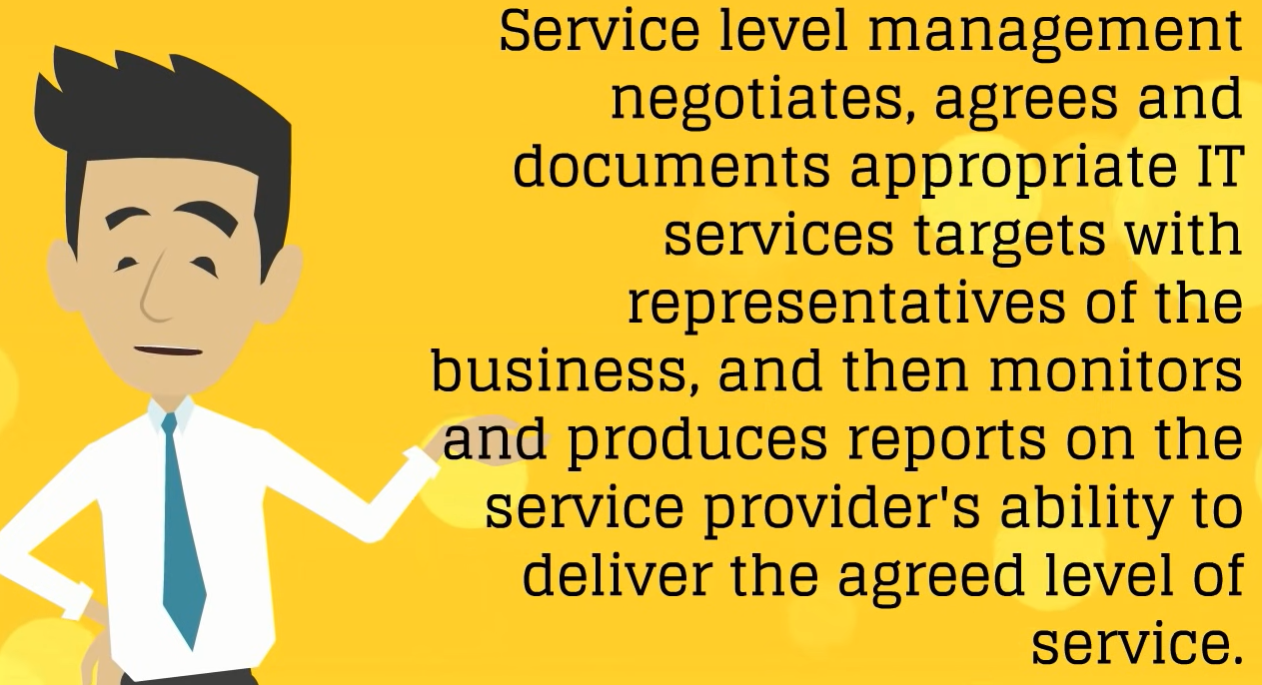

Slide 18
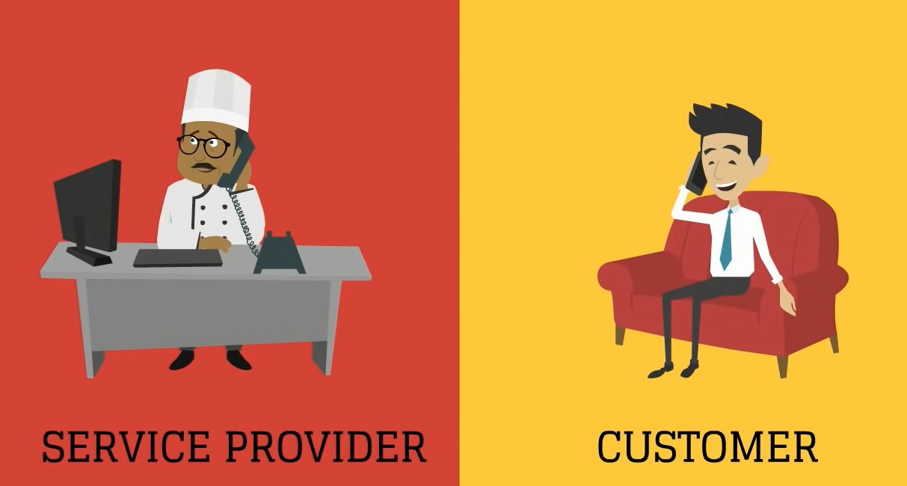

Slide 19
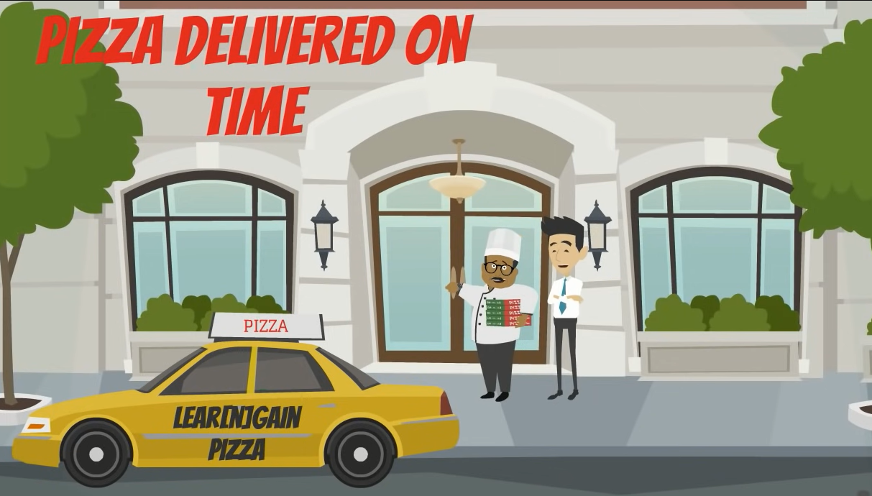

Slide 20
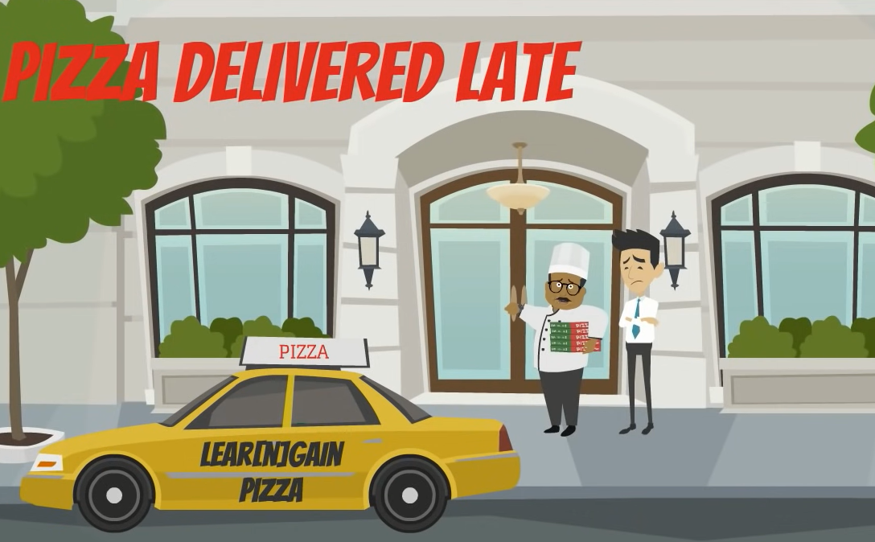

Slide 21
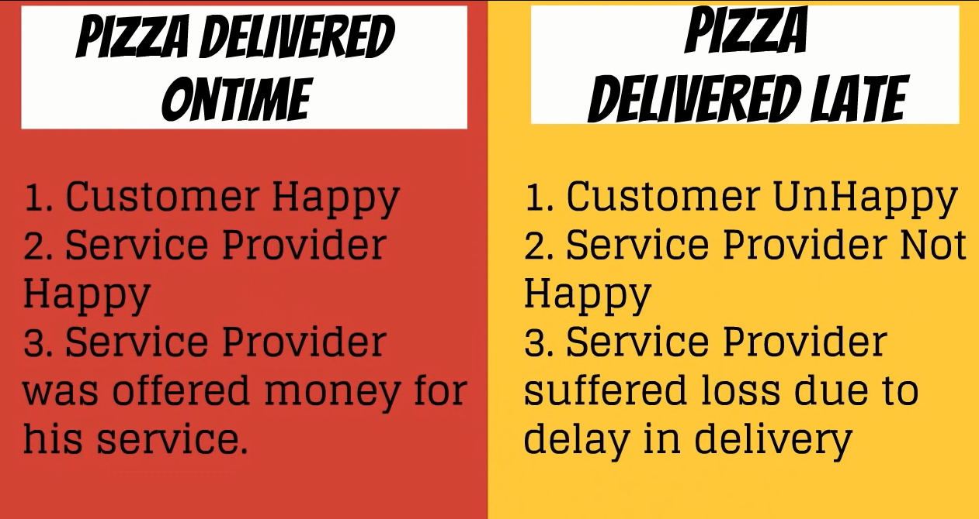

Slide 22
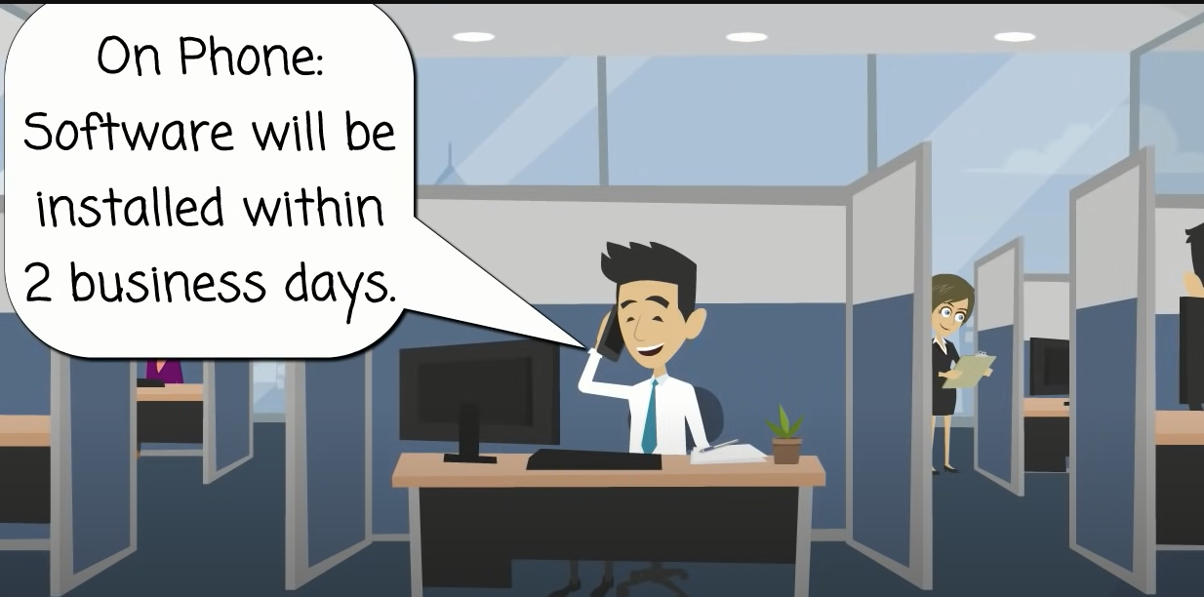

Slide 23
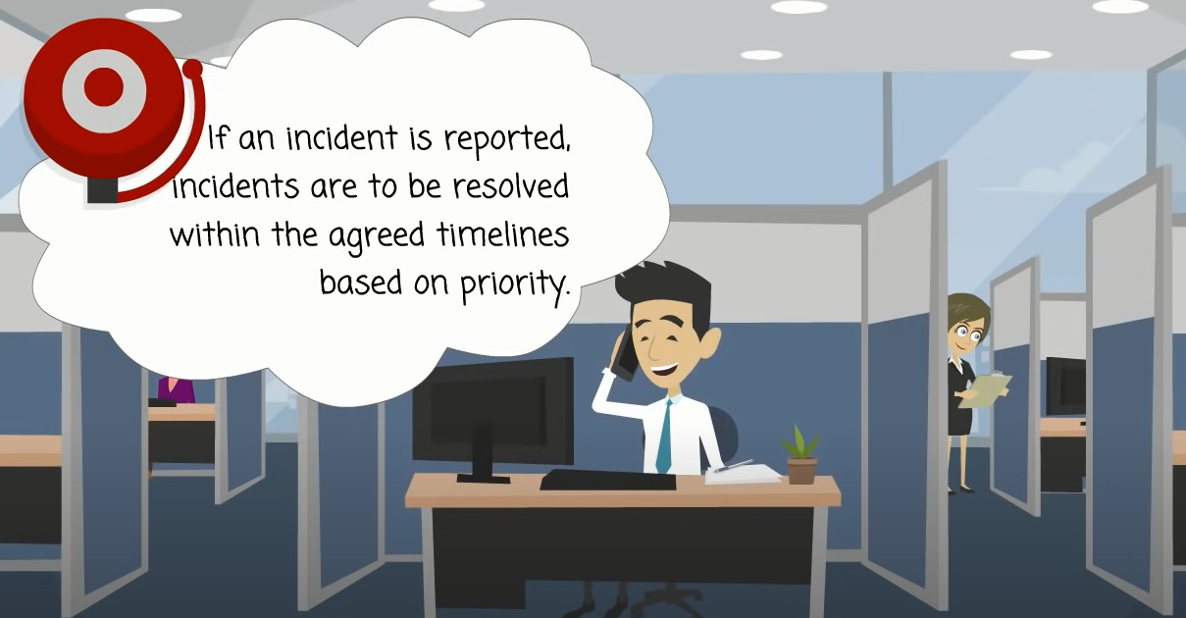

Slide 24
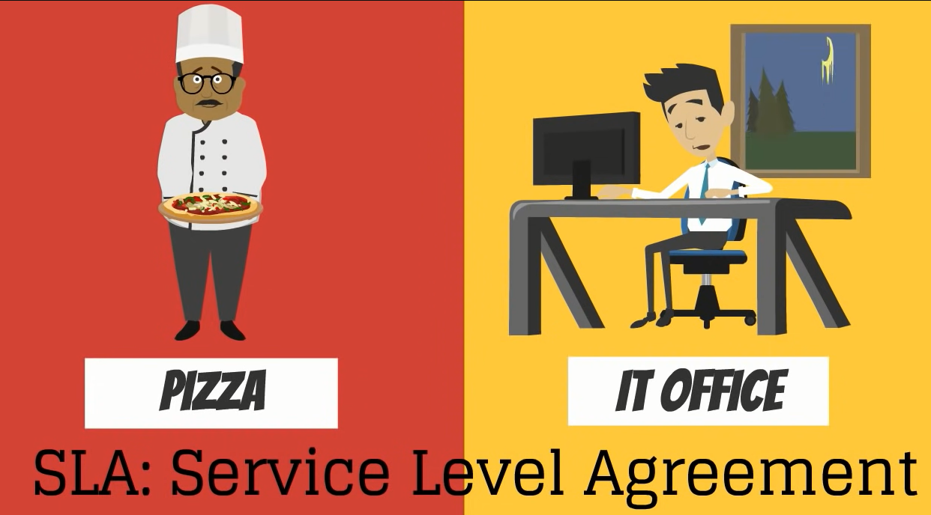

Slide 25
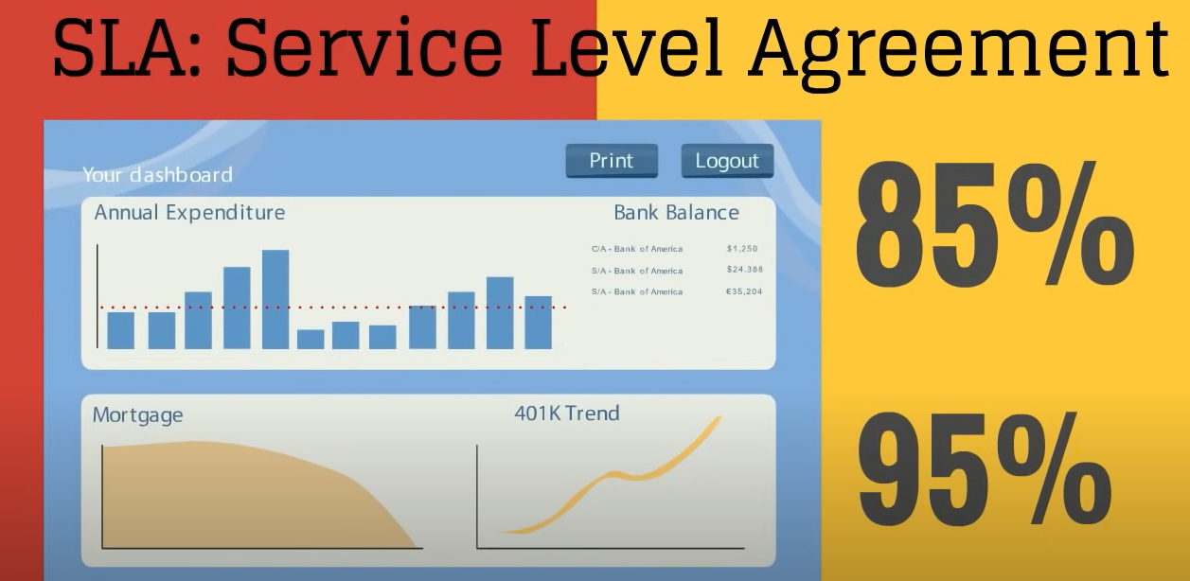

Slide 26
Change Management
Change: Addition, modification or removal of Cis(Configuration Item)
Change is an event that results in a new status of one or more configuration items and which is
Approved by management
is cost effective
enhance business process changes(fixes)
Business have two expectations
The service should be stable, reliable, and predictable
The service should be able to change rapidly to meet evolving business requirement

Slide 27
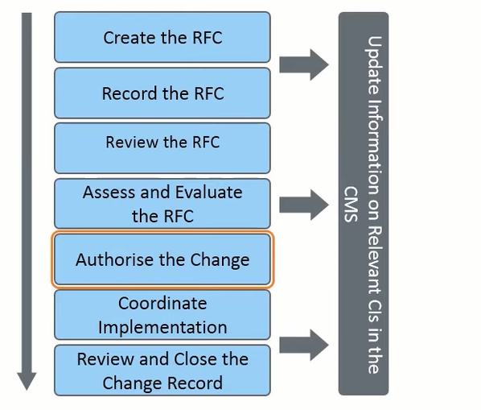
Change Management Process

Slide 28
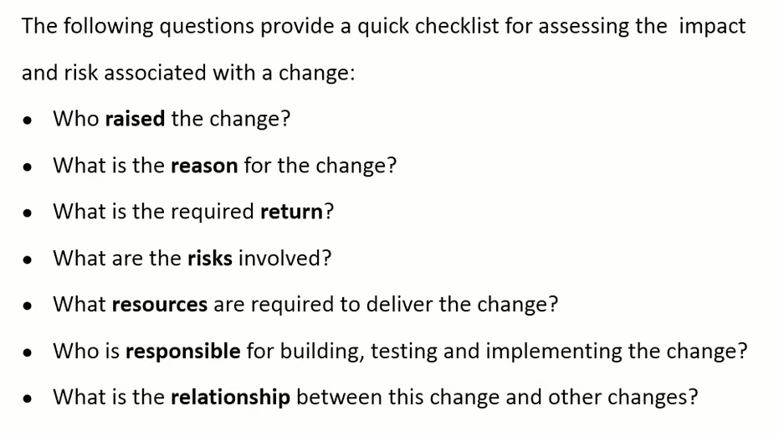
7 Rs of Change Management

Slide 29
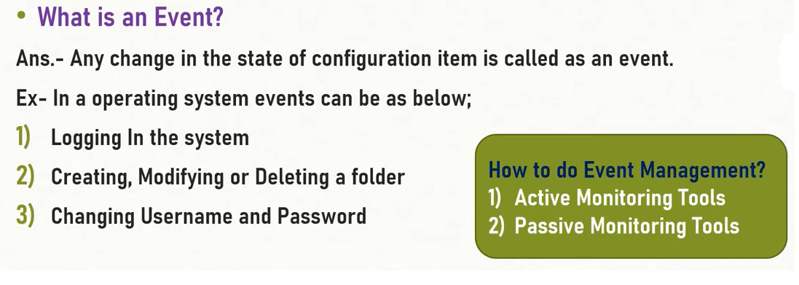
Event Management

Slide 30
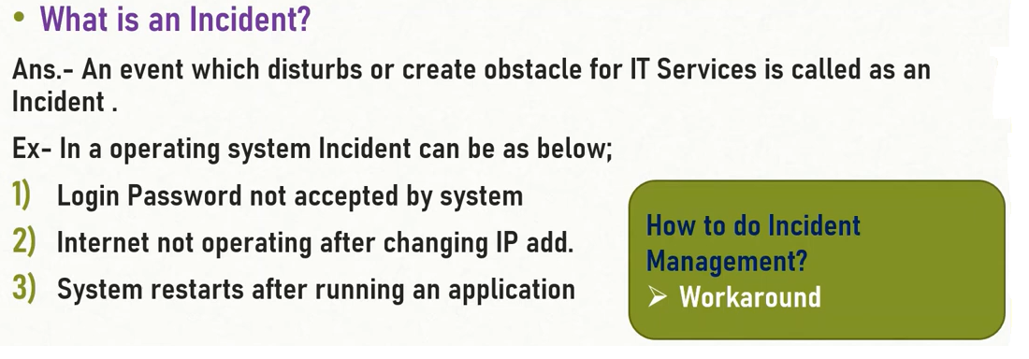
Incident Management

Slide 31

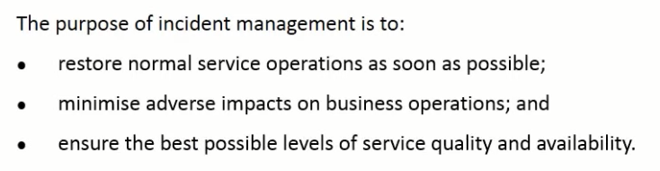

Slide 32

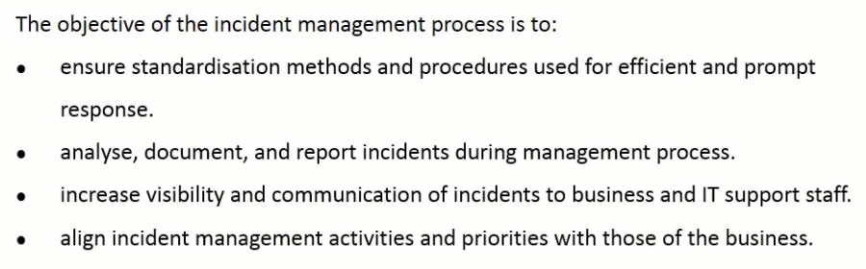

Slide 33
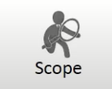
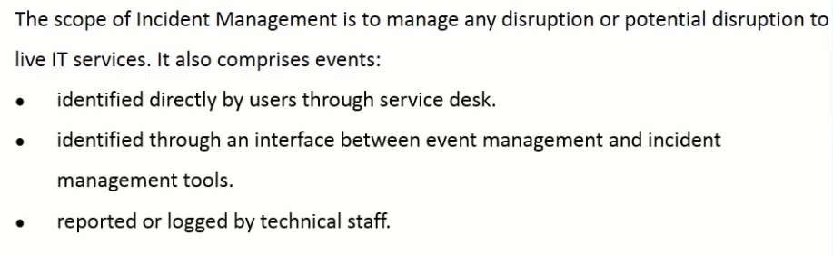

Slide 34
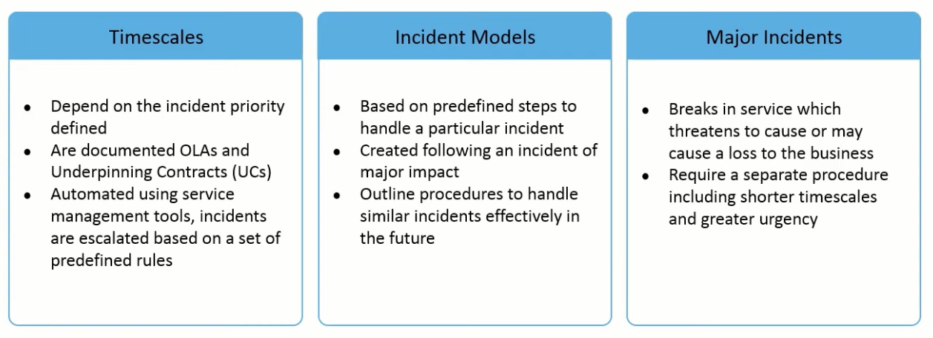

Slide 35
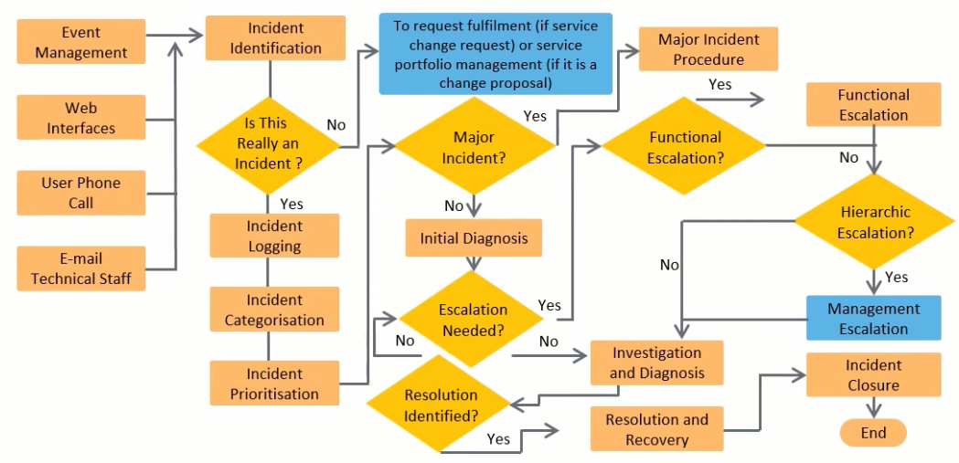

Slide 36
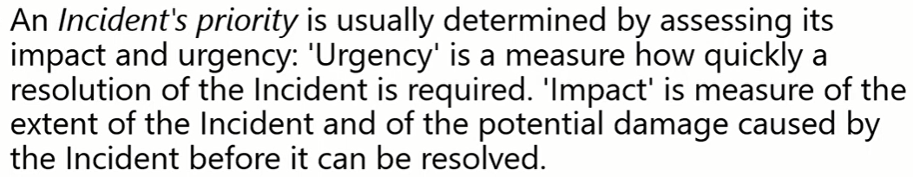
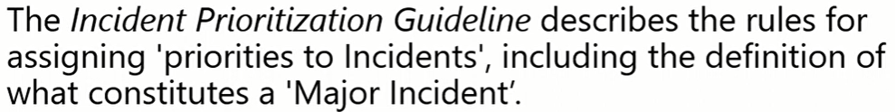
Prioritization

Slide 37
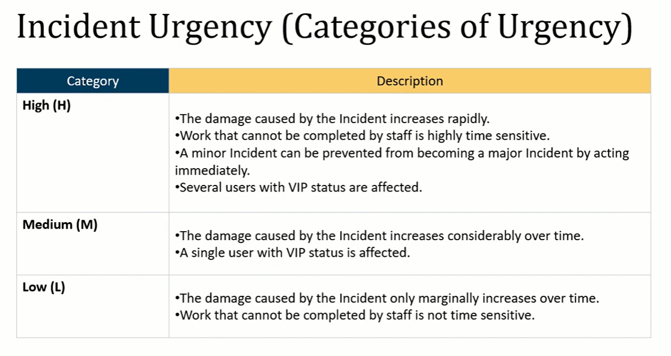

Slide 38
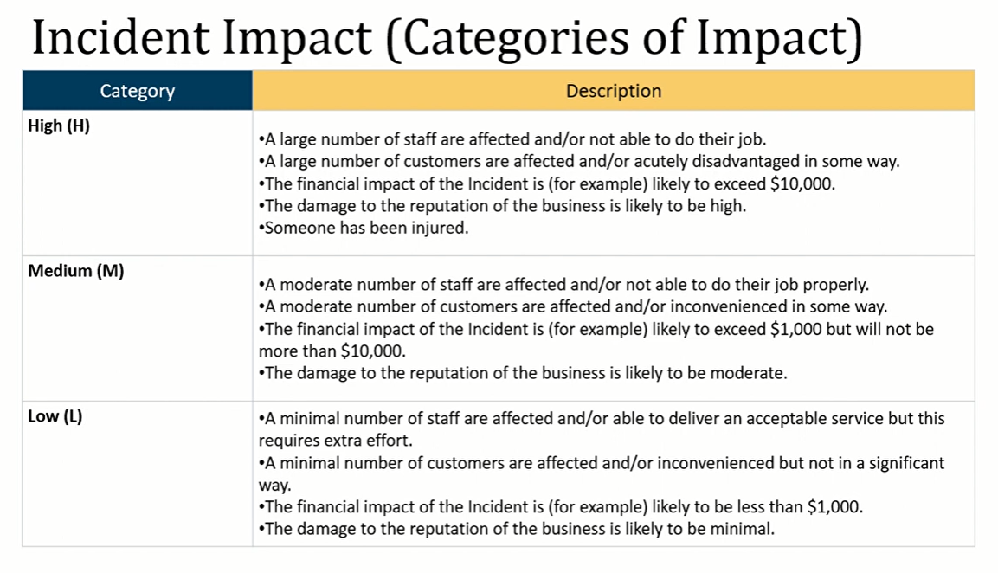

Slide 39
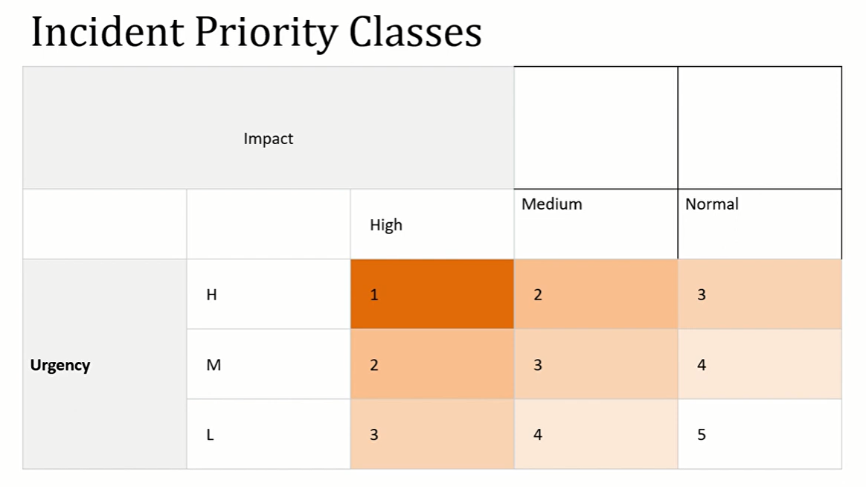

Slide 40
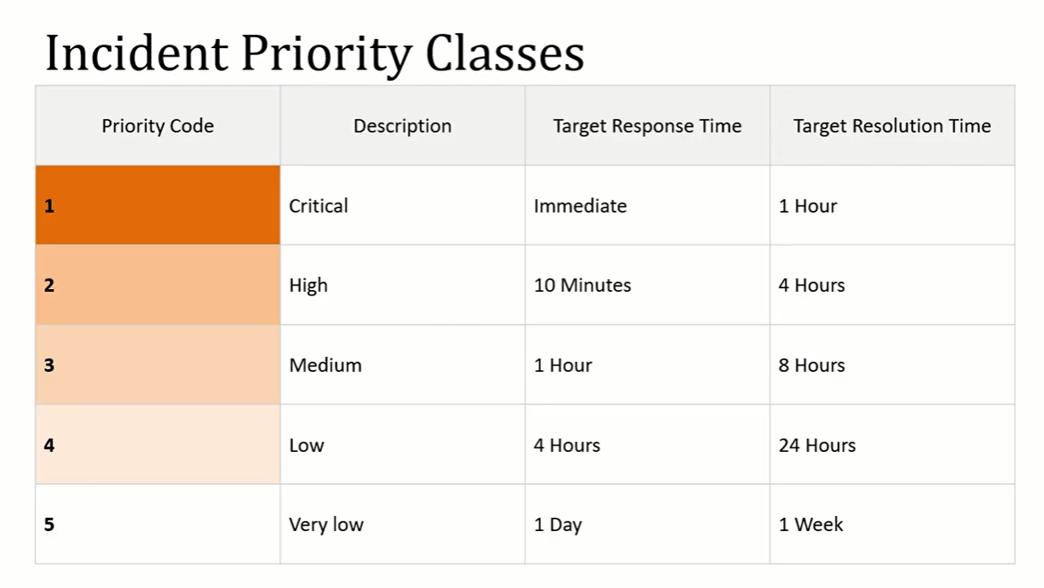

Slide 41
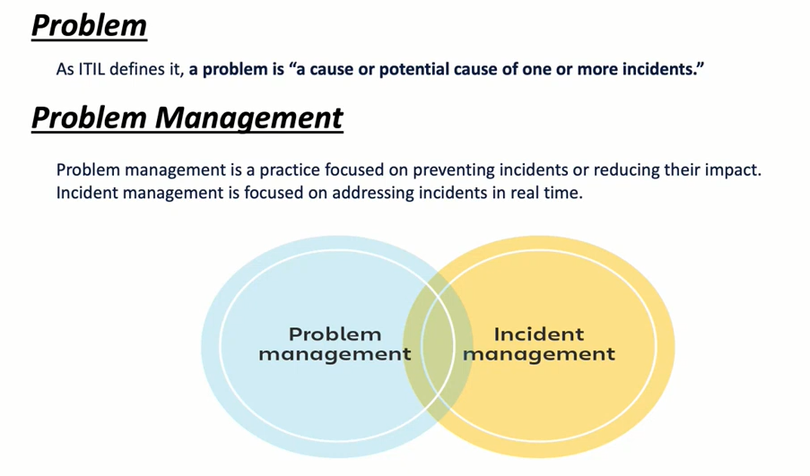

Slide 42
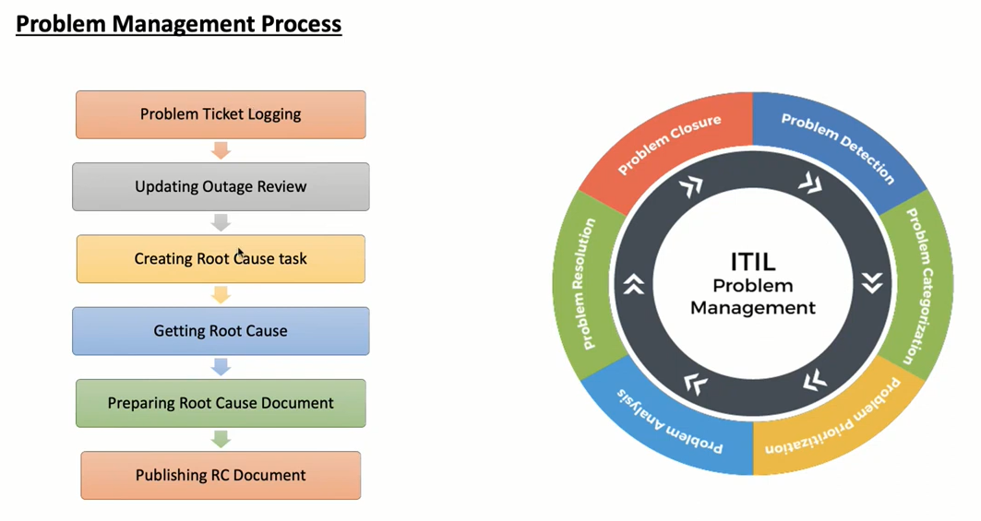

Slide 43
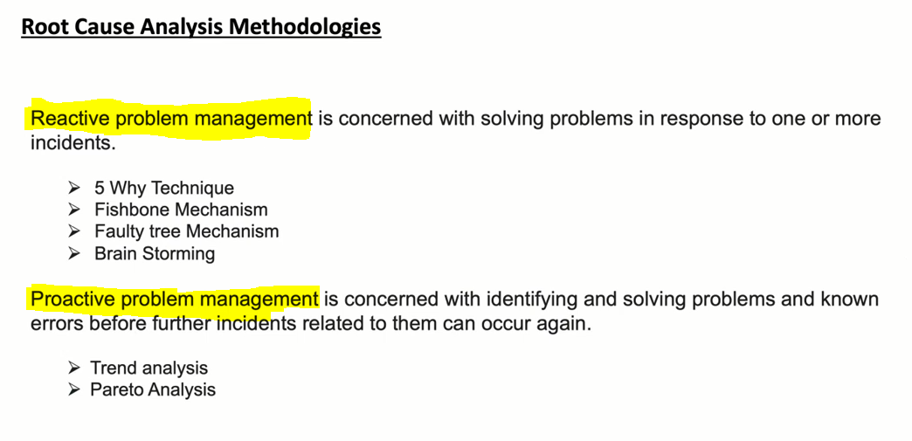

Slide 44
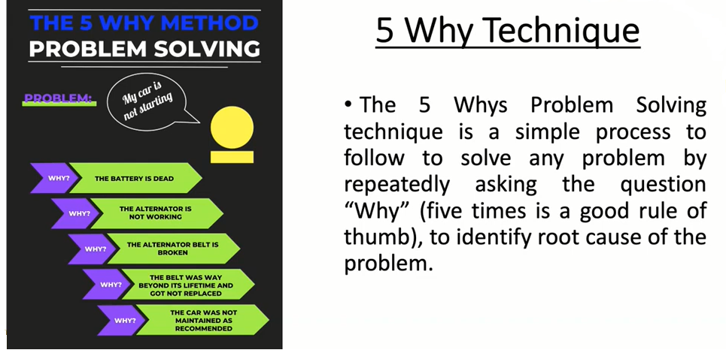

Slide 45
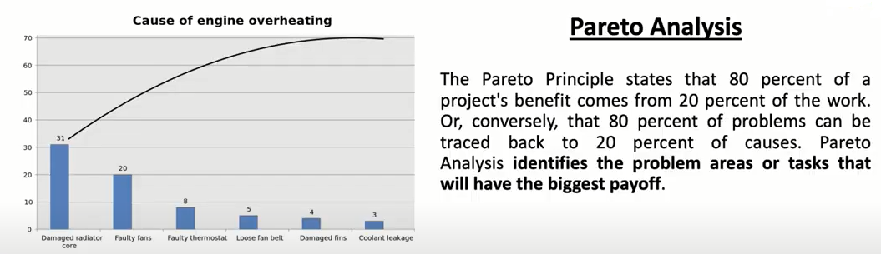

Slide 46
